Slide 1


Horror_movies DATASET
ADTA 5240 FINAL PRESENTATION
Presentation by: Group 7

Slide 2
INDEX
Team members
Data : Brief about Data
Data Collection & Generation : How is Data collected?
Data Preprocessing : Steps to clean the Data
Data Visualizations : Visual representation of Data
Data Interpretations : Findings in the Data
Data Storage : How do we store our Data?
Data Analysis/ Queries : Insights & Patterns of Data

Slide 3
Team members
NikhilChowdary.K
Responsible for Data Handling and analysis
Sai Sandeep.N
Responsible for Data interpretation and Data storage

Slide 4

DATA
Horror_movies dataset.
32,541 rows
20 columns including
[id,original_title,title,original_language,overview,tagline,release_date,poster_path,
popularity,vote_count,vote_average,budget,revenue,runtime,status,adult,
backdrop_path,genere_names,collection,collection_name].
Presence of null values, and unnecessary attributes.

Slide 5

DATA GENERATION & COLLECTION
Data Source: Tidy Tuesday
Horror_movies open data: Horror movies results from 1950 to 2022.
Mixed genres and their popularity.
Horror movie trends over the years.
Data manipulation and its importance.

Slide 6
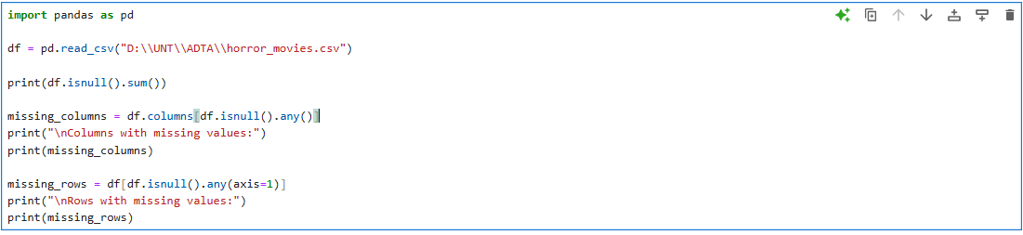
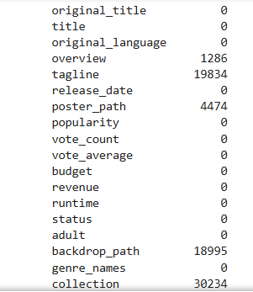
DATA PROCESSING

Slide 7
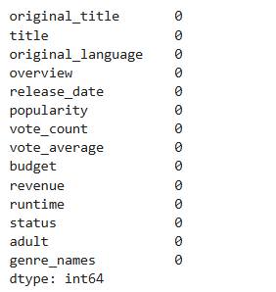
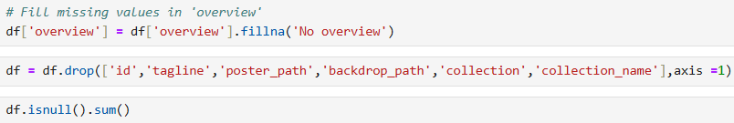
DATA PROCESSING

Slide 8
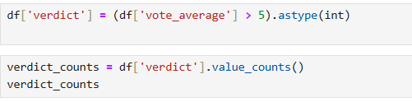
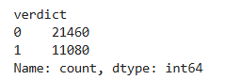
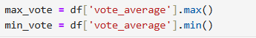
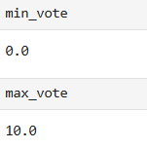
DATA PROCESSING

Slide 9
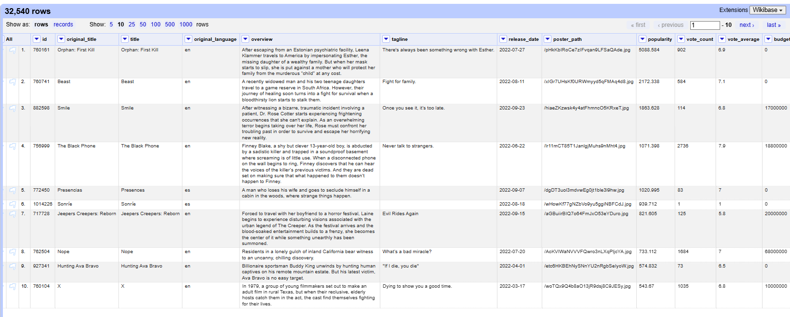
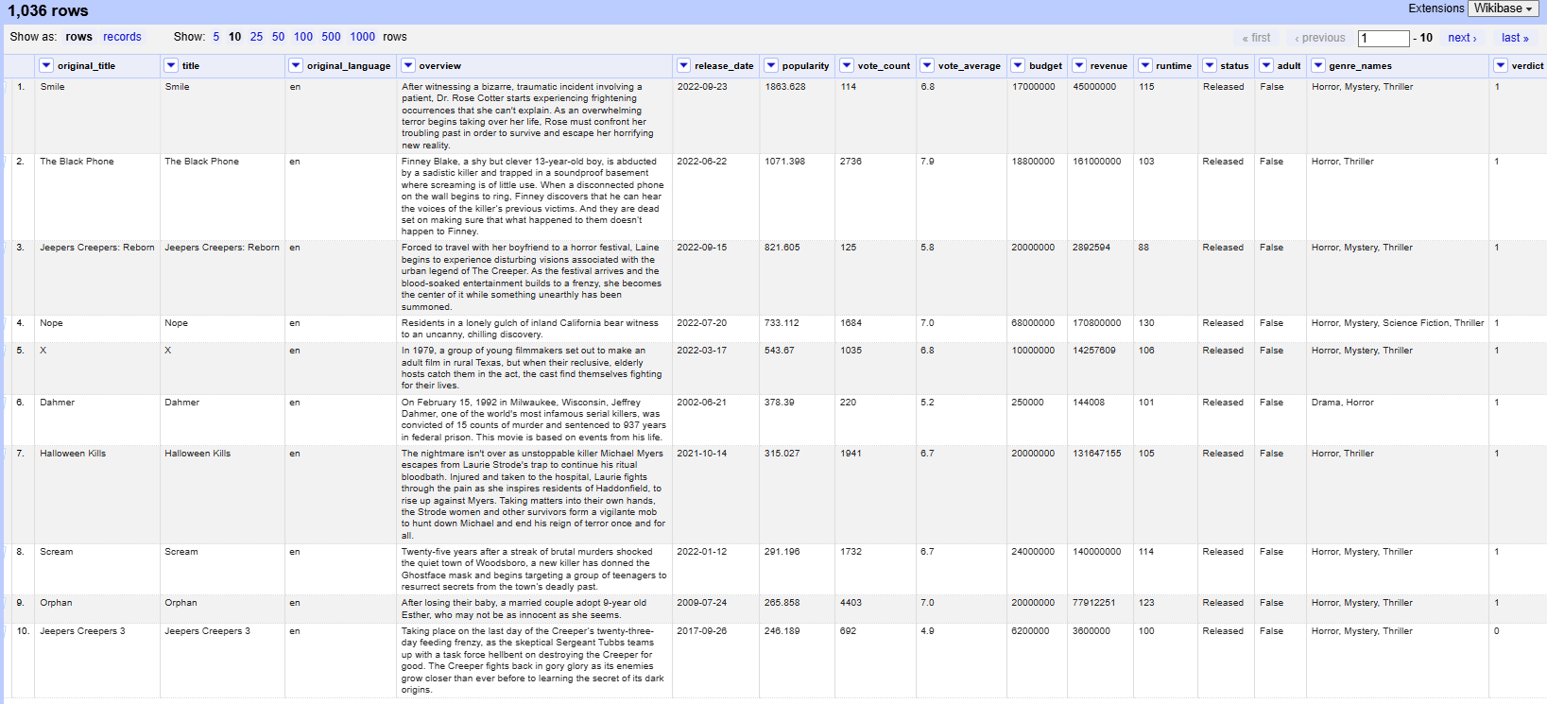
DATA PROCESSING

Slide 10
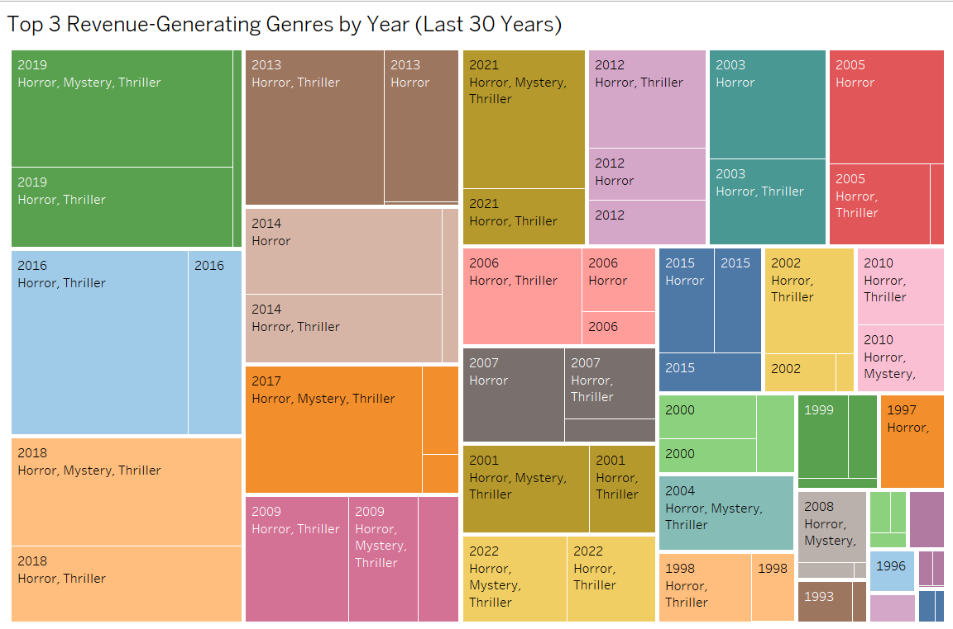
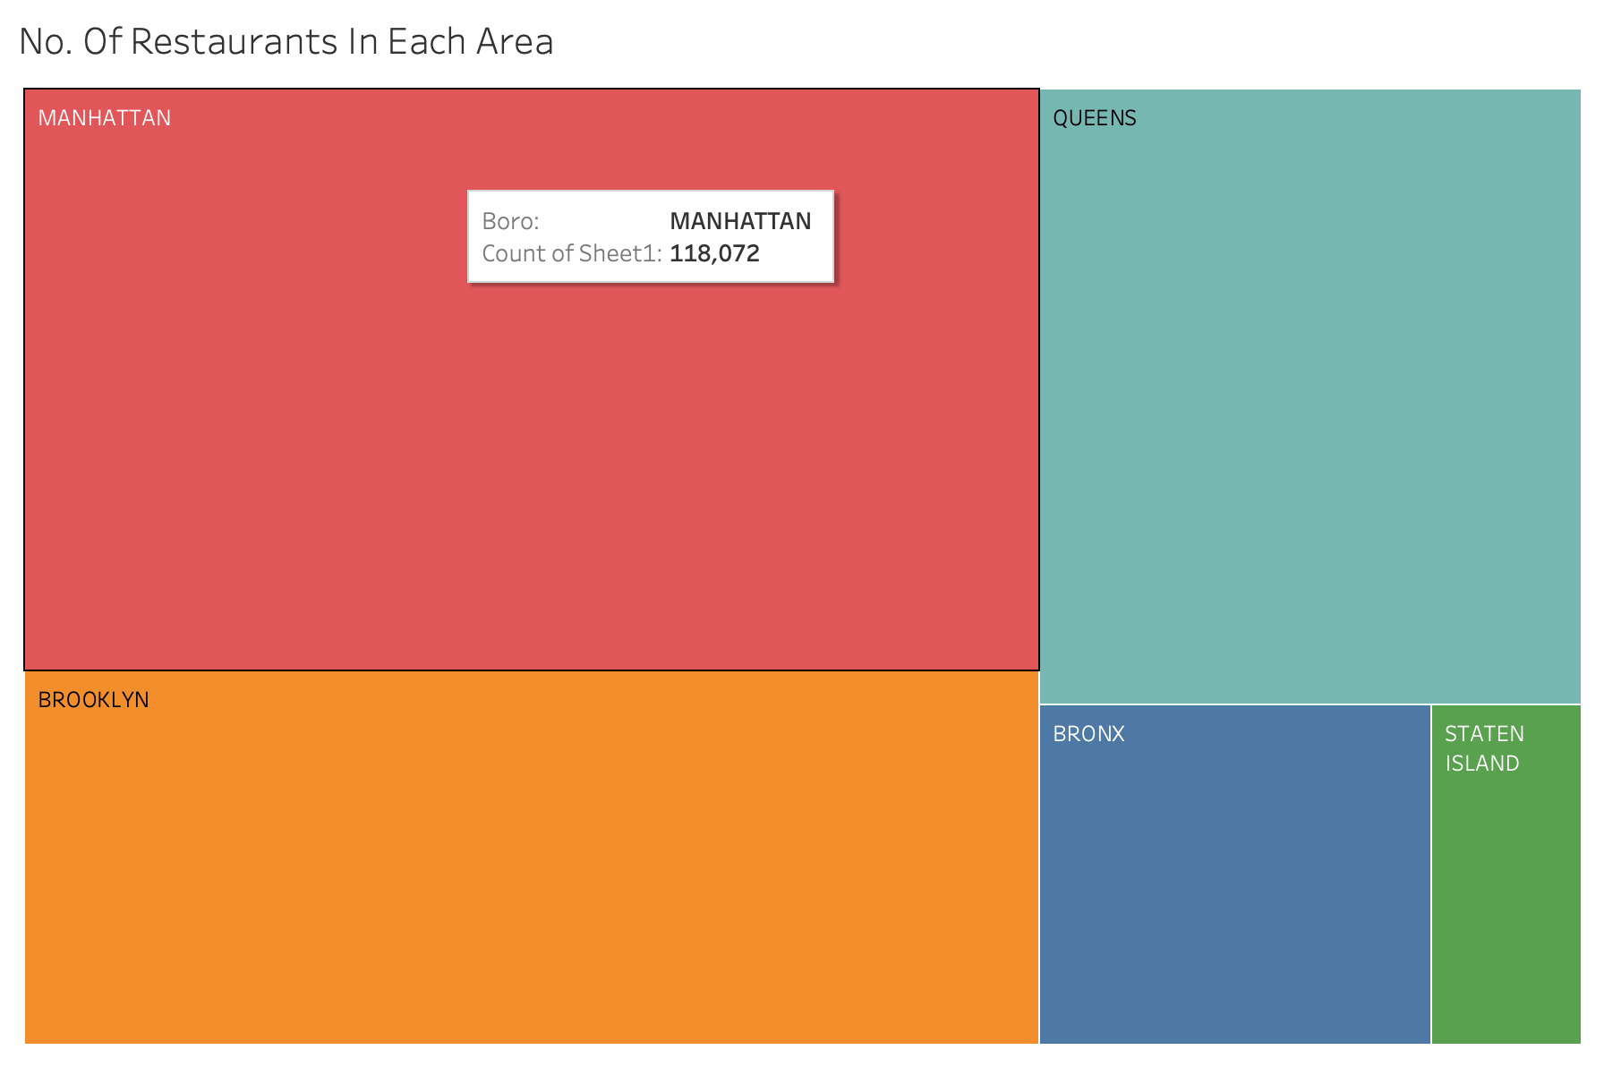
VISUALIZATIONS/INTERPRETATIONS
Top 3 Revenue
Generating Genres

Slide 11
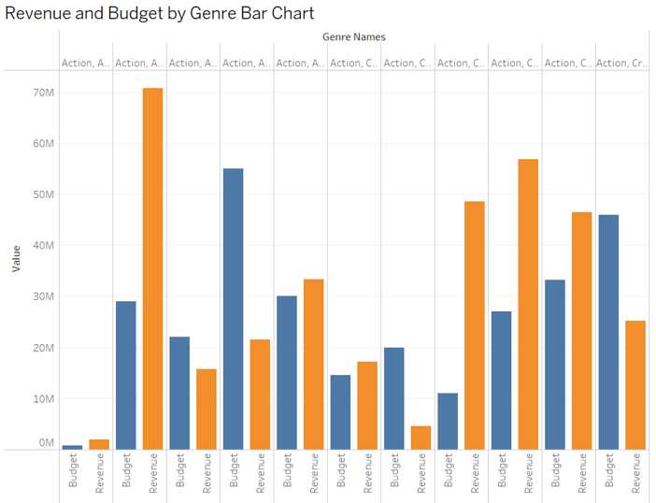
VISUALIZATIONS/INTERPRETATIONS
Revenue and Budget by Genre

Slide 12
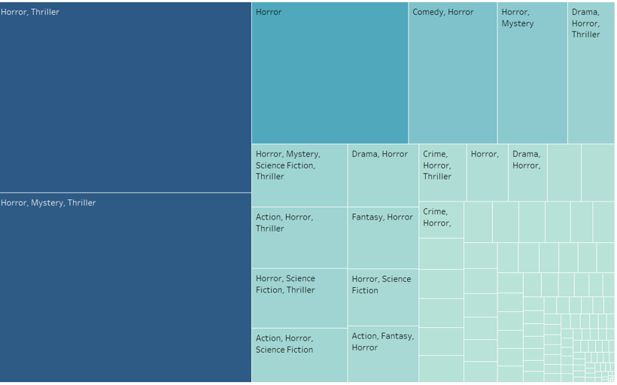
VISUALIZATIONS/INTERPRETATIONS
Popularity of movies by genre

Slide 13
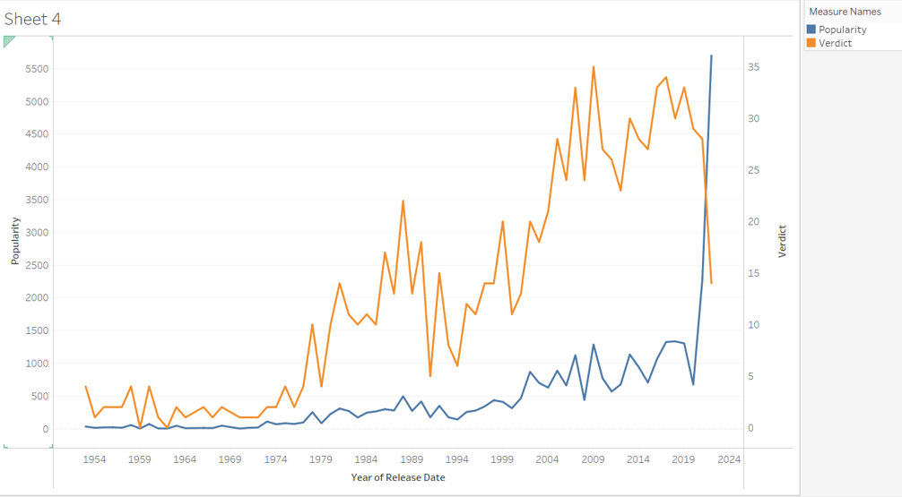
VISUALIZATIONS/INTERPRETATIONS
Verdict depends upon the popularity over the years

Slide 14
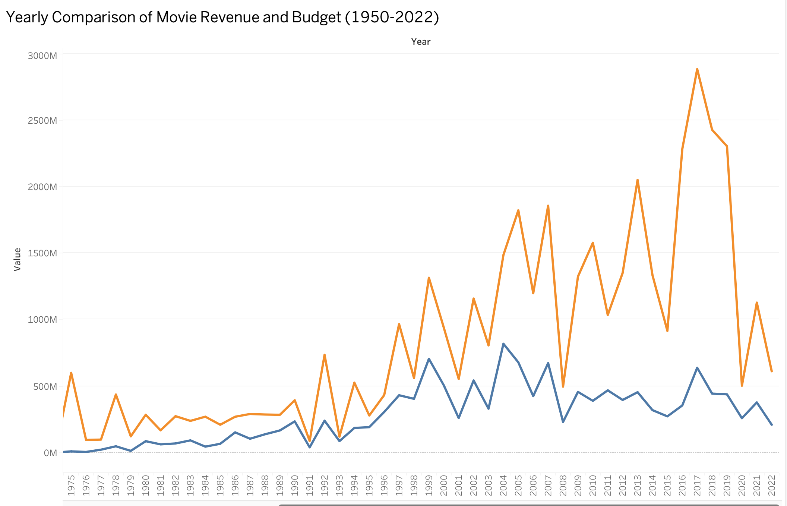
VISUALIZATIONS/INTERPRETATIONS
Yearly comparision of movie Revenue and Budget

Slide 15
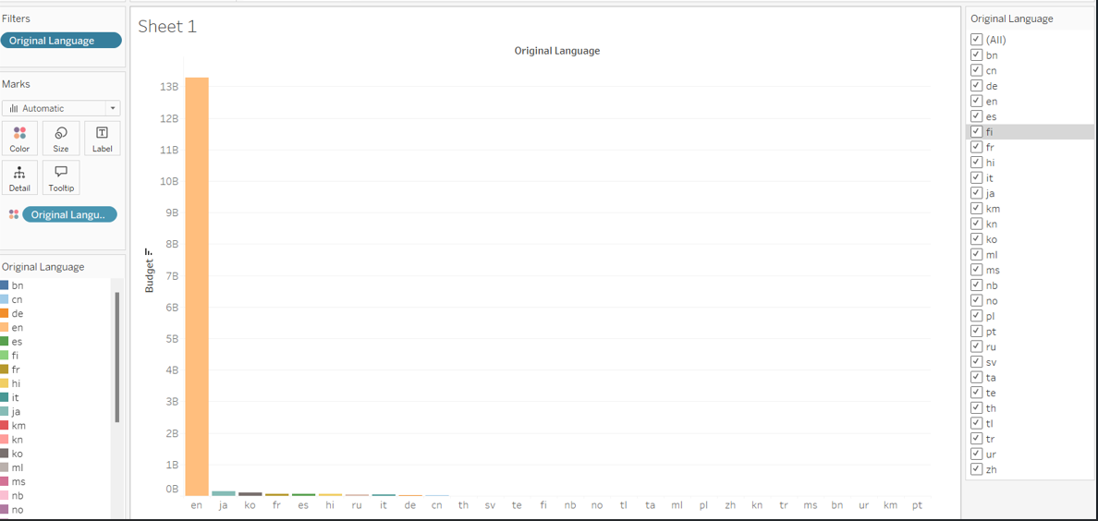
VISUALIZATIONS/INTERPRETATIONS
Comparision of movie Budgets across language

Slide 16

VISUALIZATIONS/INTERPRETATIONS
Why do some high rated movies have low popularity?
Why is the budget significantly higher for the movies in English language?
Why is the average profit higher for non-English movies in some cases?

Slide 17
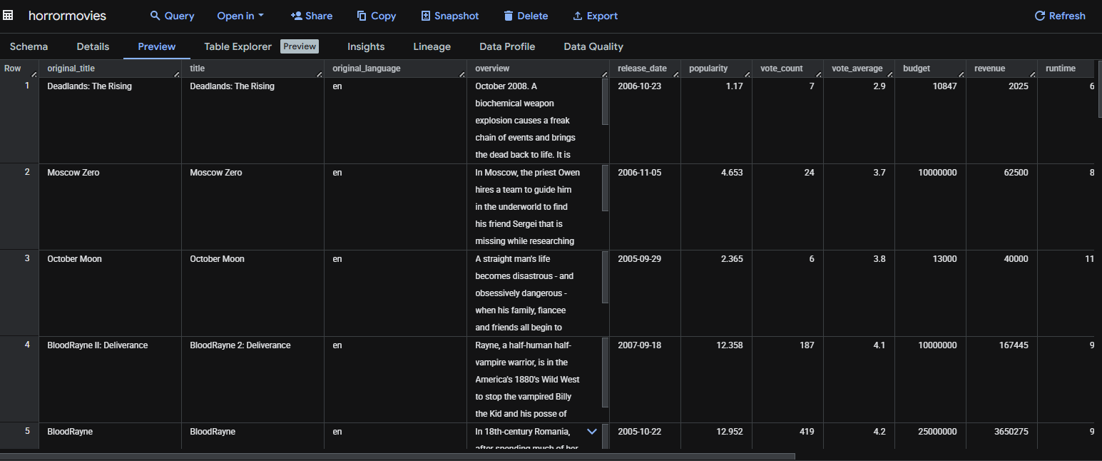
DATA STORAGE

Slide 18
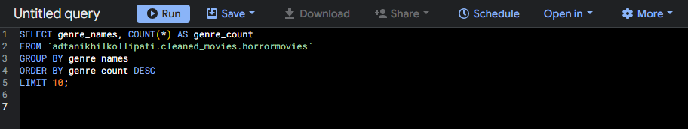
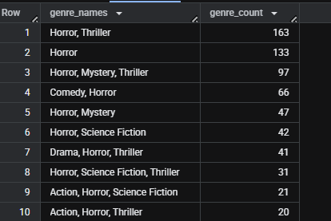
DATA ANALYSIS
Movies released based upon the genre

Slide 19
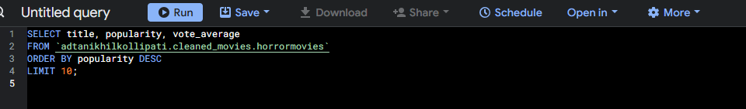
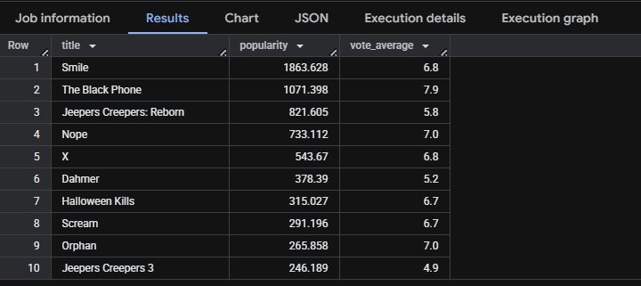
DATA ANALYSIS
Popularity does not directly reflect vote average

Slide 20
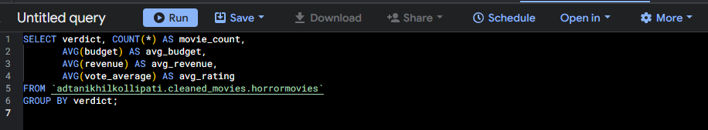
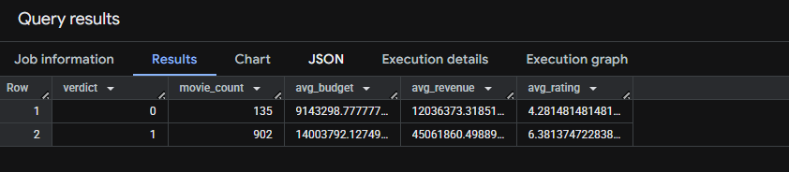
DATA ANALYSIS
Overall Metrics by verdict

Slide 21
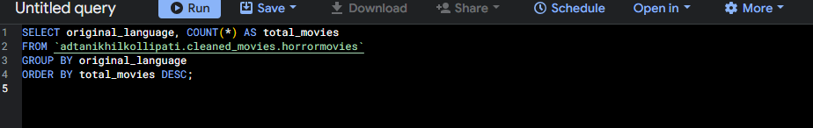
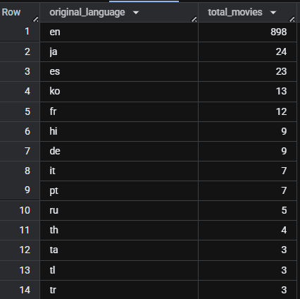
DATA ANALYSIS
Movies statistics by language

Slide 22
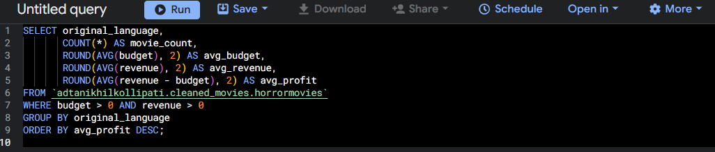
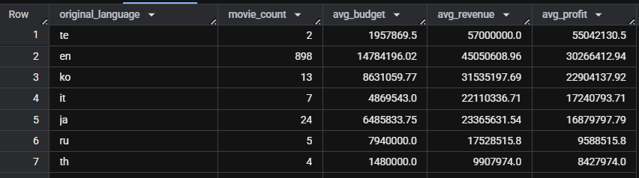
DATA ANALYSIS
Language based analysis of movie count and Finacials

Slide 23
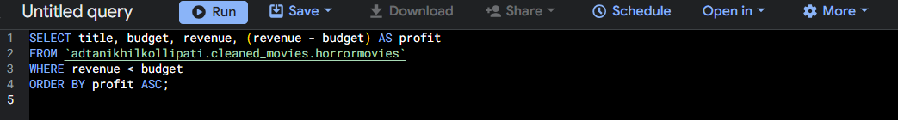
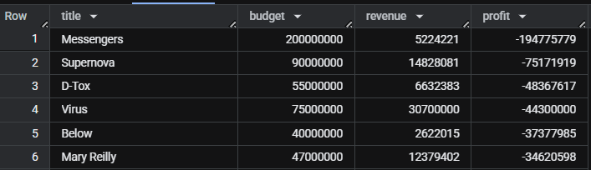
DATA ANALYSIS
Loss analysis of movies based on Budget and Revenue

Slide 24

DATA ANALYSIS
What patterns can be observed among the top 10 highest-grossing movies?
What proportion of movies actually generate a profit?
What roles does language play in the movies financial success?
What kind of movies tend to perform best globally?
What type of movies are most likely to get a positive verdict?

Slide 25


